Slide 1
Standing waves in air columns

Slide 2
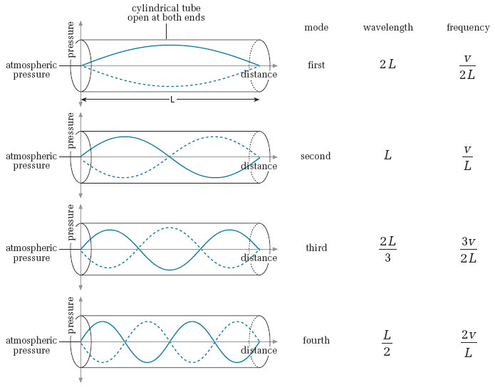
Open-Ended Air columns Pressure-distance diagram

Slide 3

The Equation
$$λ=\frac{2l}{n}$$
λ = wavelength
l = length of the string
n = mode of the wave (number of antinodes in a pressure-distance diagram)
Also called harmonic number

Slide 4
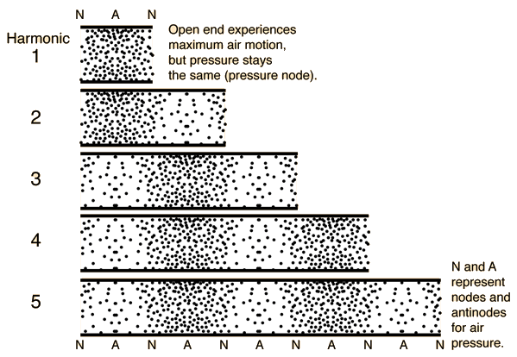

Slide 5
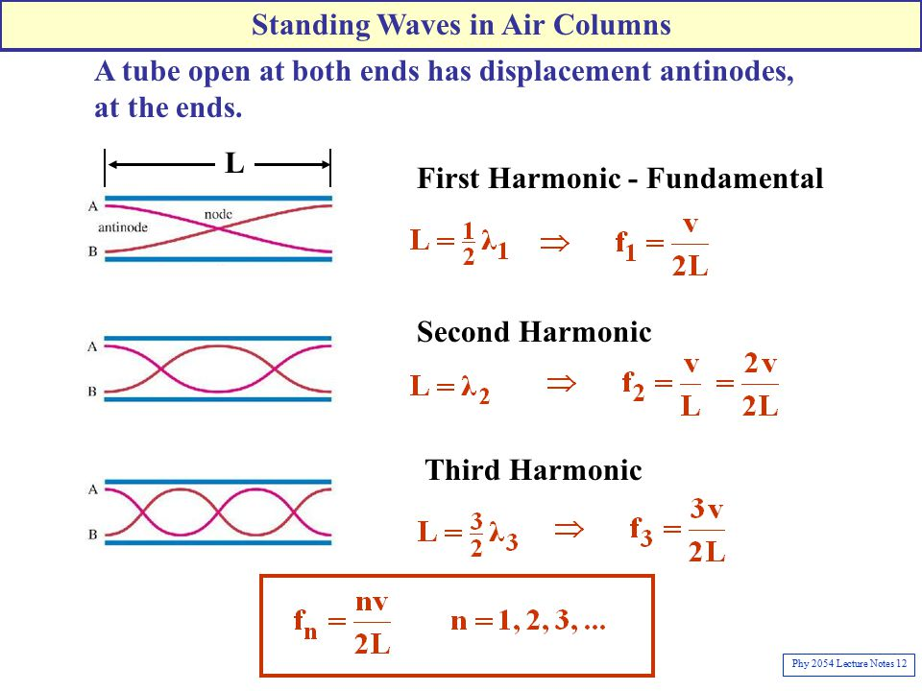
Open-ended air columns Displacement-distance diagram

Slide 6
Some notes
The open ends will always be at the ambient air-pressure, therefore there will be a pressure node
At the pressure anti-nodes there is maximum pressure. These particles cannot move so therefore is a displacement node.
Pressure node = displacement antinode

Slide 7
Closed air columns
These refer to pipes or tubes that are closed at one end and remain open at the other.
For both strings and open-ended columns, the reflections of the waves at the ends are the same at both ends- with a change of phase. (the wave flips)
For a closed, reflections off the closed end will not be inverted.
So an ‘up’ will be reflected as an ‘up’.
This means maximum pressure of the incident wave will interfere with maximum pressure of the reflected wave, leading to a pressure antinode

Slide 9
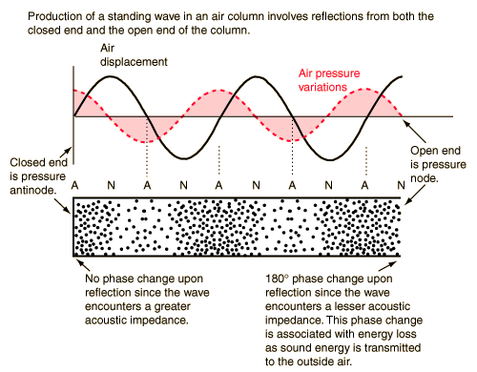

Slide 10

The equation
$$λ=\frac{4l}{(2n−1)}$$
λ = wavelength
l = tube length
n = mode of the wave
Only odd-numbered harmonics are possible
$$harmonic number=2n−1$$

Slide 11
